Slide 1
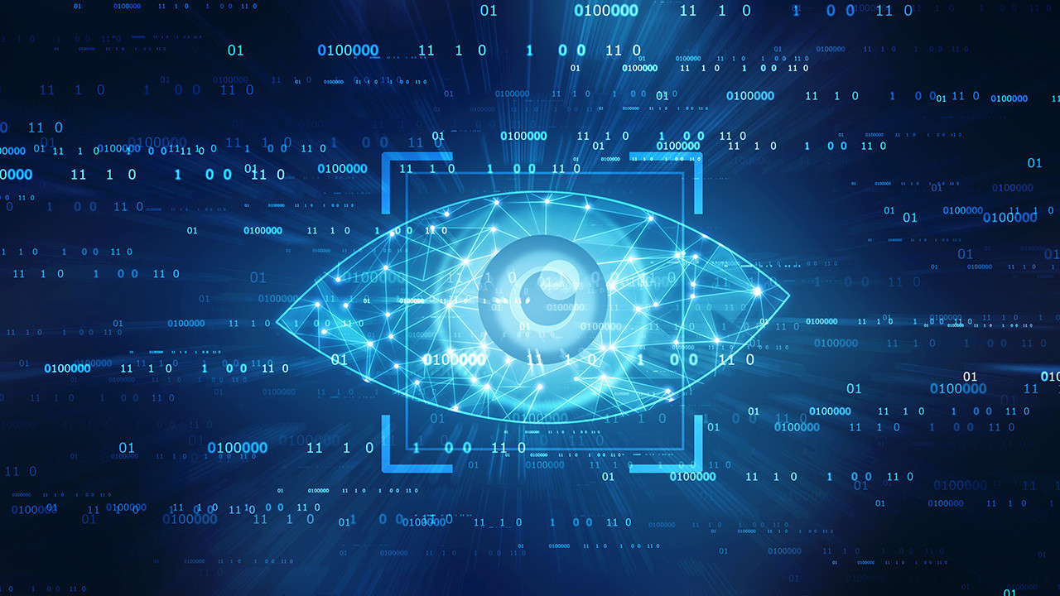
IET SMP 2021-Computer Vision

Slide 2
Welcome Guys!!!
Instructors:
M.T.Aakash Chandra-2nd Year CSE
Email: aakash.191cs132@nitk.edu.in
Contact:9110272655
Aprameya Dash -2nd Year IT
Email: aprameyadash.191it209@nitk.edu.in
Contact:7735784564

Slide 3
Topics to be covered today (Session 6)
The main topics which we will be looking in depth today are:
Introduction to neural networks.
Introduction to CNNs
Applications of CNNs

Slide 4
Introduction to Neural Networks

Slide 5
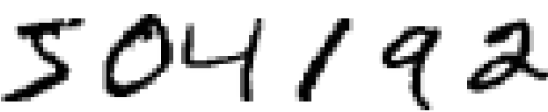
Inspiration
How do you think your brain recognises the digits in the above image?
How do you think a machine can recognise those digits?
Do you think you can develop an algorithm that describes how you recognised the digits?
The concept of neural networks arises directly from how information is received, perceived and processed by the brain.

Slide 6
Neural Networks
“An Artificial Neuron Network (ANN), popularly known as Neural Network is a computational model based on the structure and functions of biological neural networks. It is like an artificial human nervous system for receiving, processing, and transmitting information in terms of Computer Science”

Slide 7
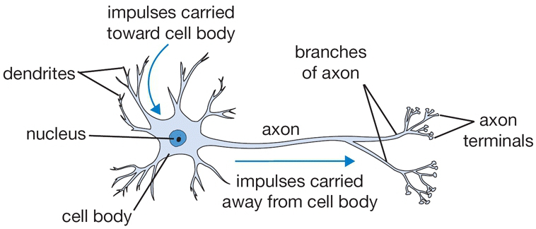
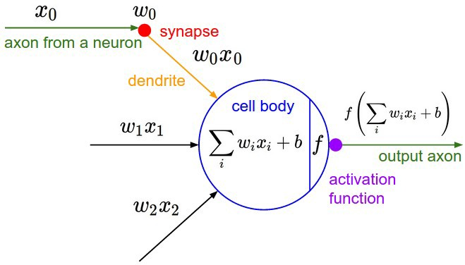
Similarities

Slide 8
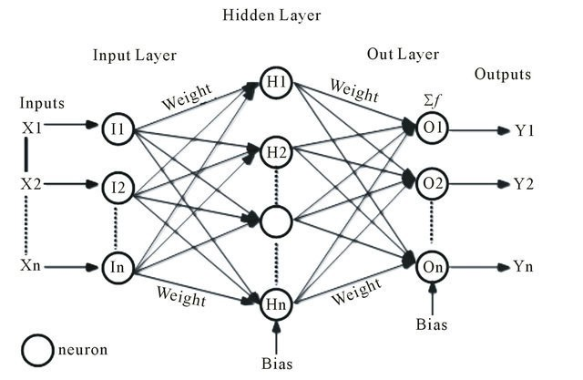
Structure of Neural Networks
There are 3 different layers in a neural network :-
Input Layer (All the inputs are fed in the model through this layer)
Hidden Layers (There can be more than one hidden layers which are used for processing the inputs received from the input layers)
Output Layer (The data after processing is made available at the output layer)

Slide 9
Activation Functions
An activation function is a function that is added into an artificial neural network in order to help the network learn complex patterns in the data.
It takes in the output signal from the previous cell and converts it into some form that can be taken as input to the next cell.
Why do we need activation functions?
To restrict the value of the output to a certain limit as per our requirement.
To add non linearity into a neural network.
Examples: Sigmoid, softmax, tanh, ReLU etc.

Slide 10
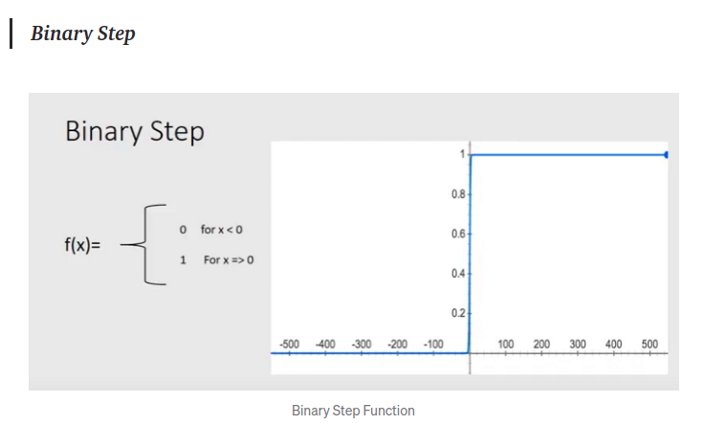
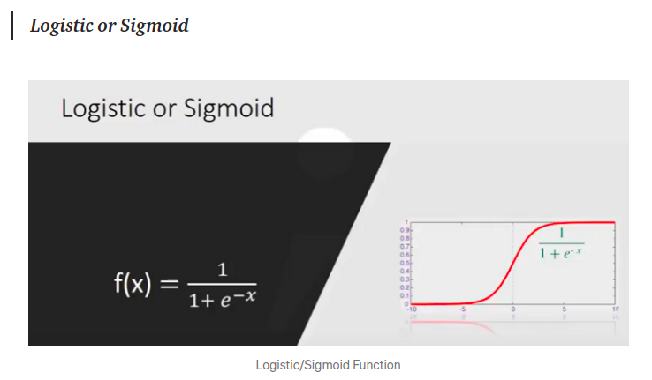
Activation Functions (Examples)

Slide 11
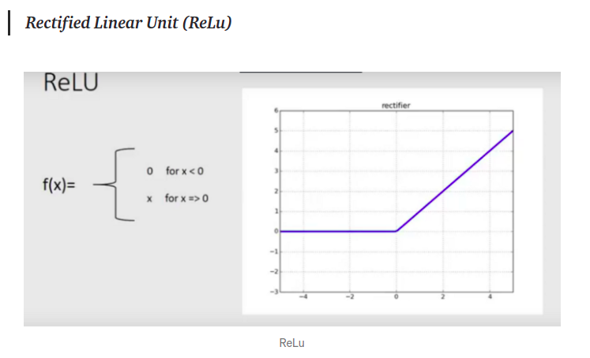
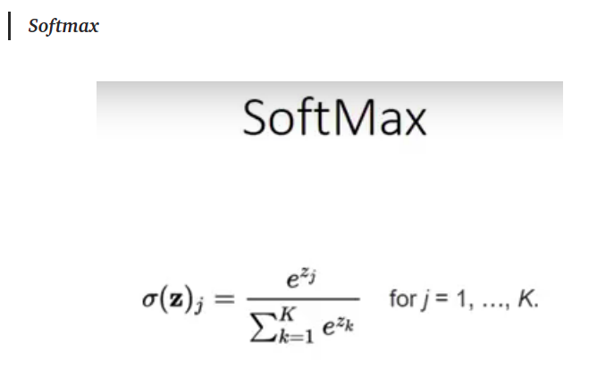
Activation Functions (Examples)

Slide 12
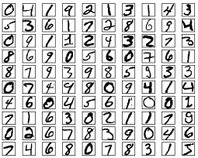
Working of neural networks
Let’s look at the previously explained example of handwritten digit recognition.
The idea is to take a large number of handwritten digits, known as training data, and then develop a system which can learn from those training examples.
In other words, the neural network uses the examples to automatically infer rules for recognizing handwritten digits.

Slide 13
Working of neural networks
A neural network is born in ignorance. It does not know which weights and biases will translate the input best to make the correct guesses.
For a neural network to be able to do something, the first step after creating the neural network is to train it on some training data.
While training, it has to start out with a guess, and then try to make better guesses sequentially as it learns from its mistakes.
The network measures the error due to its guess, and walks the error back over its model, adjusting weights to the extent that they contributed to the error.
As the training progresses, the weights get updated and the network becomes better and better progressively.

Slide 14
Introduction to Convolutional Neural Networks

Slide 15
Convolutional Neural Networks (CNNs)
“A Convolutional Neural Network (ConvNet/CNN) is a Deep Learning algorithm which can take in an input image, assign importance (learnable weights and biases) to various aspects/objects in the image and be able to differentiate one from the other.”

Slide 16
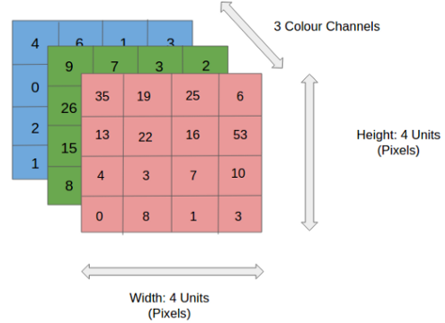
Why CNNs?
In the figure, we have an RGB image which has been separated by its three color planes — Red, Green, and Blue.
The role of the CNN is to reduce the images into a form which is easier to process, without losing features which are critical for getting a good prediction.
A CNN can understand the sophistications of an image in a better way by capturing the important features and reducing the number of parameters.

Slide 17
Kernel & Convolution
1 | 1 | 1 | 0 | 0
0 | 1 | 1 | 1 | 0
0 | 0 | 1 | 1 | 1
0 | 0 | 1 | 1 | 0
0 | 1 | 1 | 0 | 0
1 | 0 | 1
0 | 1 | 0
1 | 0 | 1
Image
Kernel

Slide 18
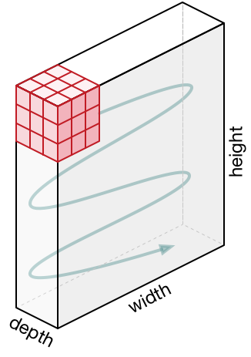
Movement of Kernel
Movement of kernel in a image with 3 channels
Convolution with padding
Convolution Operation with Stride Length = 2

Slide 19
Pooling
The Pooling layer is responsible for reducing the spatial size of the Convolved Feature.
This is to decrease the computational power required to process the data through dimensionality reduction.
Furthermore, it is useful for extracting dominant features which are rotational and positional invariant, thus maintaining the process of effectively training of the model.
There are two types of Pooling: Max Pooling and Average Pooling. Max Pooling returns the maximum value from the portion of the image covered by the Kernel. On the other hand, Average Pooling returns the average of all the values from the portion of the image covered by the Kernel.

Slide 20
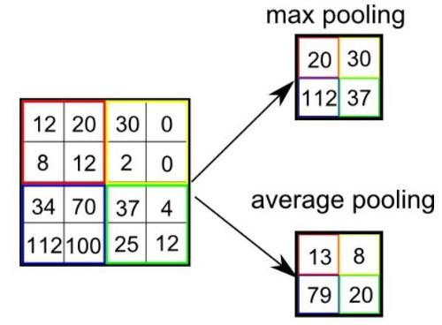
Pooling
Max and Average Pooling
Max Pooling Demo

Slide 21
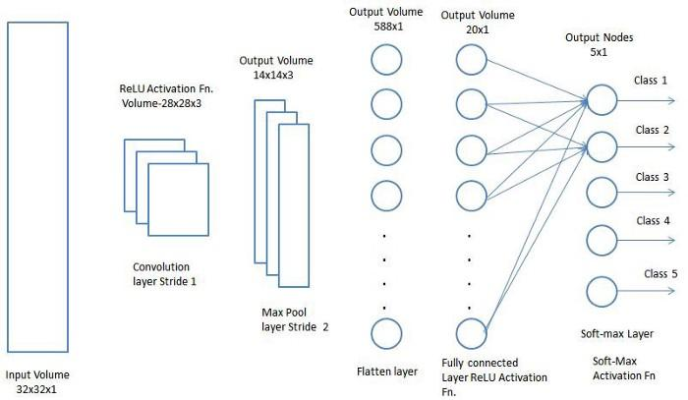
CNN Architecture

Slide 22
Applications of Convolutional Neural Networks

Slide 23
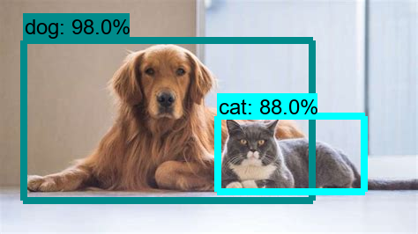
Image Classification

Slide 24
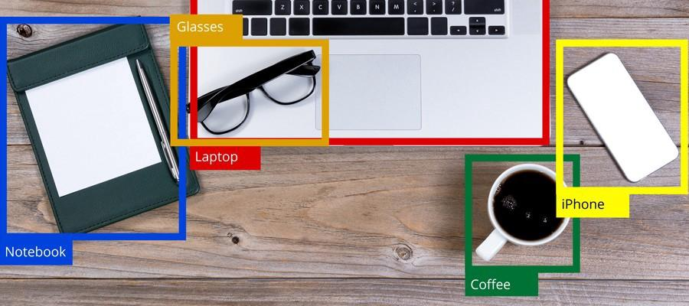
Image Classification

Slide 25
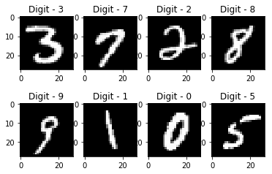
Handwriting recognition

Slide 26
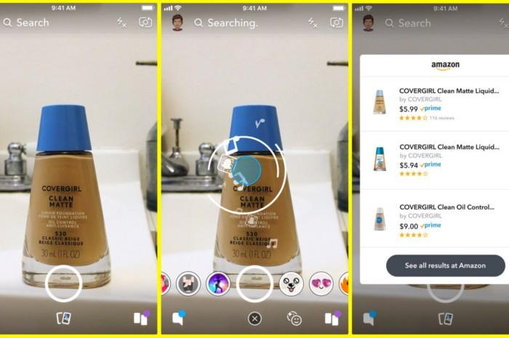
Image recognition

Slide 27
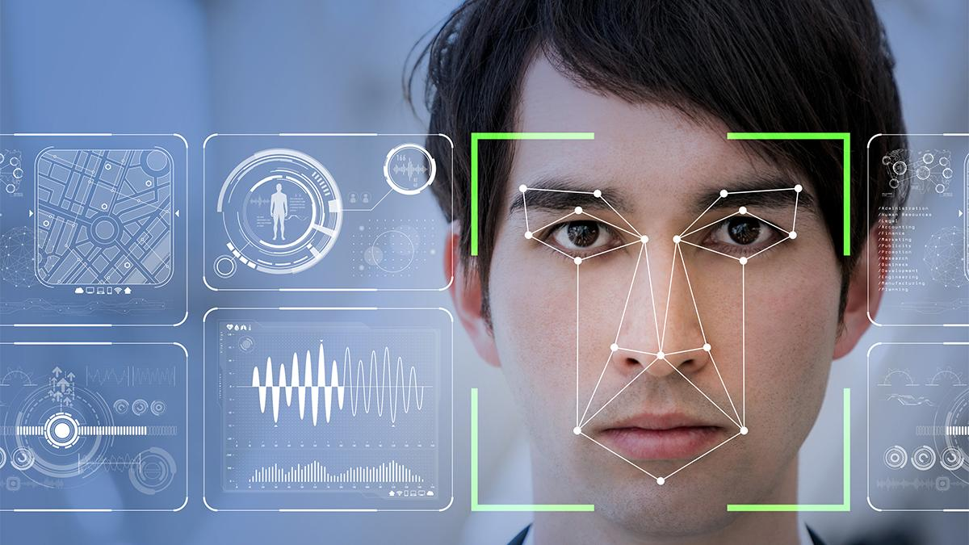
Face recognition

Slide 28
Thank You Guys!!

